Slide 1
102424 HTRA1 PFF 1K WT

Slide 2
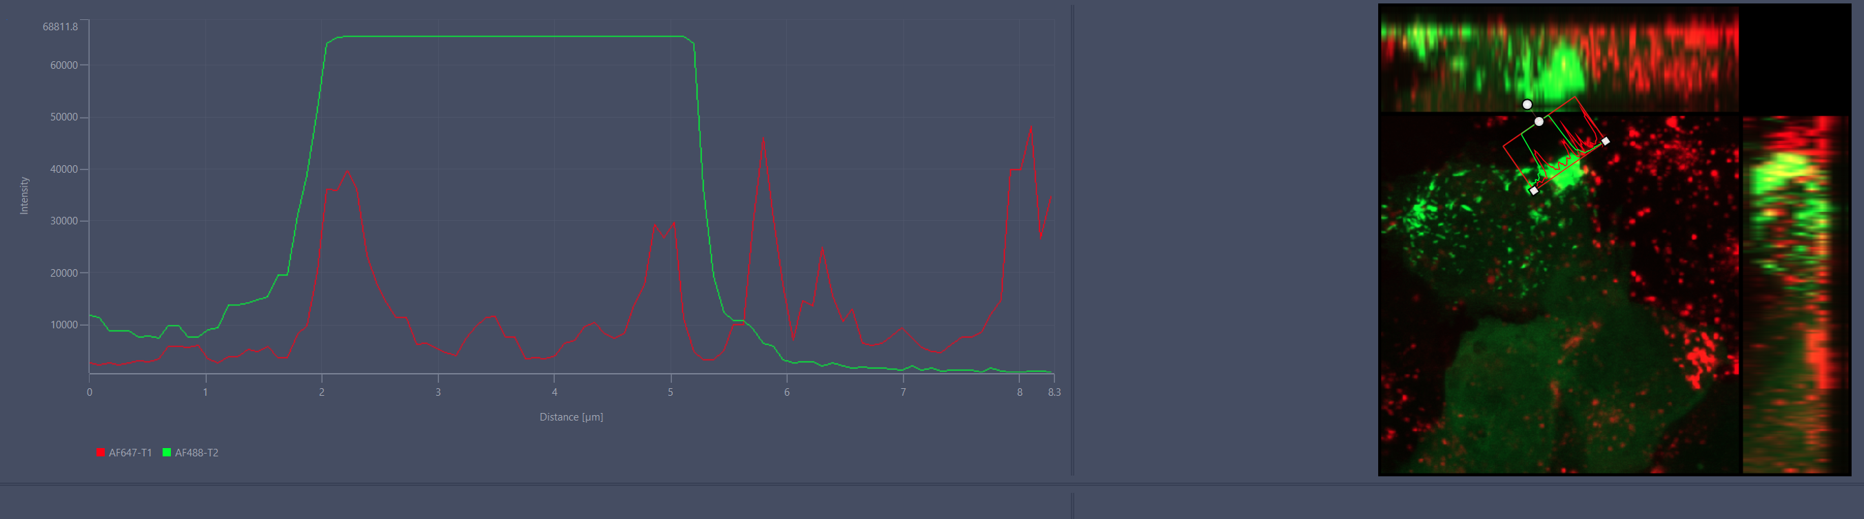
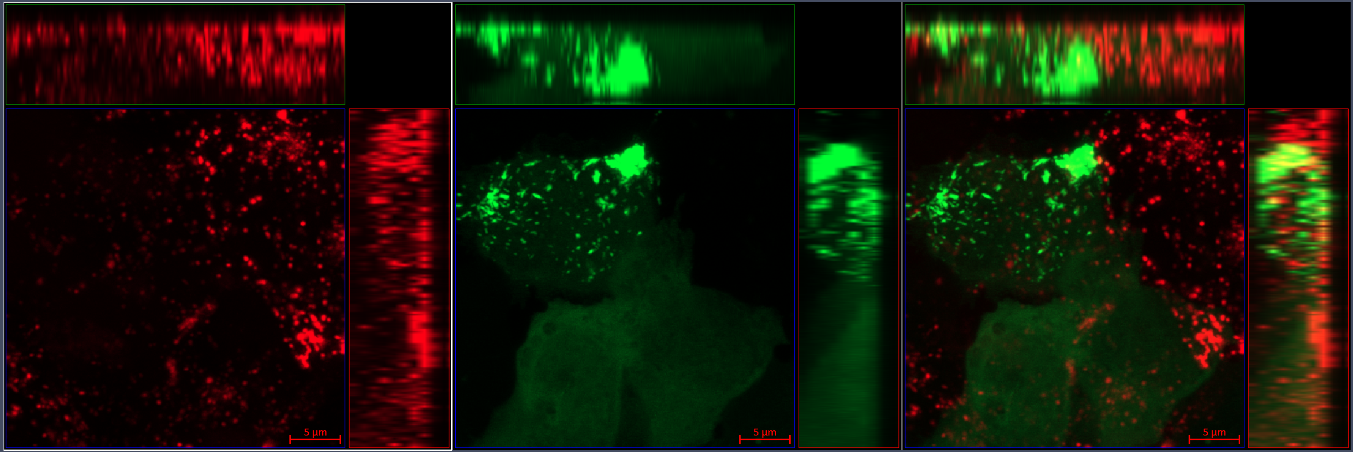
Notes:
1K_PFF_HTRA1_zstack_MIP_01

Slide 3
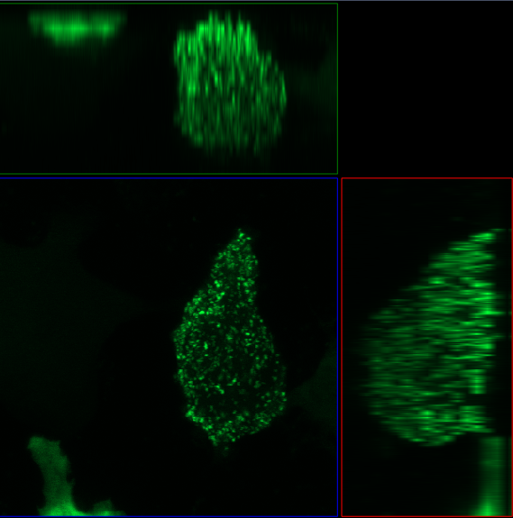
Notes:
1K_PFF_z-stack_MIP_07

Slide 4
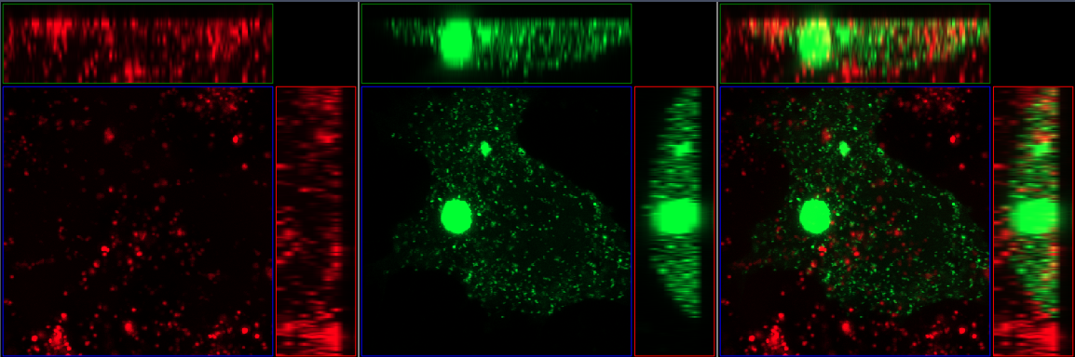
Notes:
Wt_PFF_HTRA1_z-stack_MIP_04

Slide 5
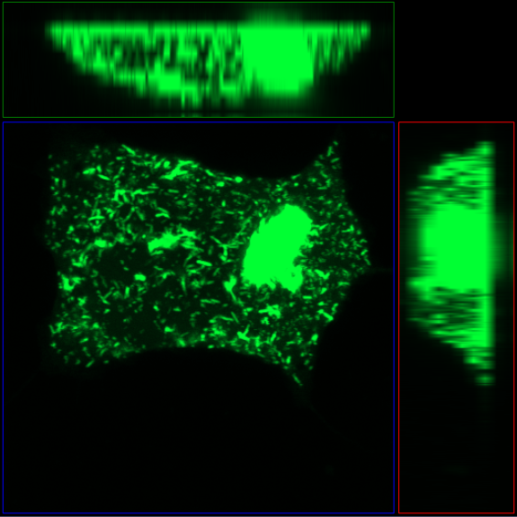
Notes:
Wt_PFF_z-stack_MIP_07

Slide 6
1K PFF + HTRA1
HTRA1-647
aSyn-YFP
Merge
PFF + HTRA1
1k
PFF
PFF + HTRA1
WT
PFF

Slide 7
